Slide 1
Parents’ Meeting
Introduction to Read Write Inc.
Notes:
Approximately 20 minutes is needed for this session.
Notes are provided to help you lead the presentation.
Notes in italics are for your attention only.
This bitesize parent session is designed as an introduction to Read Write Inc when you first implement the programme in your school and for parents of new YR children each September.
Use the other bitesize parent PPTs throughout the year to discuss and practise how they can help their child at home based on the child’s group.
Notes are provided to help you lead the presentation.
Notes in italics are for your attention only.
Provide copies of ‘Reading at Home Booklet 1 or 2’ from Oxford Owl.
Booklet 1 is sound groups and Ditty/ Red Groups and Booklet 2 for Green – Grey Storybooks.

Slide 2

Reading changes everything
Notes:
Read quote.
This is what we do in our school.
Research shows that children who learn to read quickly go on to succeed in school and in life.
Today I want to help you understand how your child is learning to read with phonics – specifically ‘Read Write Inc.’ Phonics.

Slide 3
What is phonics?
Teaching children to read by learning sounds and blending them together to read words.
s-a-t s-t-a-m-p t-r-ai-n
Teaching children to spell words using the sounds that they know.
Notes:
All words are made up of individual sounds. These sounds are merged together to form words.
e.g. in ‘mat’ we have the sounds ‘m’, ‘a’, ‘t’, ship – ‘sh’, ‘i’, ‘p’.
Click A grapheme is another name for the letters we use to write the sound. The spelling of that sound on the page.
Phonics is the method of teaching reading through the identification of sounds and graphemes.
The new National Curriculum ensures that all children are taught Phonics systematically.
This gives your children the tools to read any word.

Slide 4
Read Write Inc. Phonics
Systematic phonics scheme used to teach children in Reception, Year One and Year Two who are learning to read. For children who fall behind the expected standard at the end of Year 2, the teaching of phonics also continues into Key Stage 2
Children are taught in groups based on their stage of reading.
Children are assessed regularly to ensure all children practice reading at the correct level.
Notes:
Who Is Read Write Inc Phonics for?
(Click) Phonics is for children in Reception, Y1 and Y2 who are learning to read.
Each half-term, we assess and group our children based on their stage of reading not age of reading. This means all children practise reading at the right level.

Slide 5
Speed Sounds Set 1 and Set 2
We start off by teaching children one way of reading and writing every sound.
We teach letter sounds, not letter names.
We use pure sounds
Notes:
Using RWI, we make learning to read easy for children because we start by teaching them just one way of reading and writing every sound. Here they are on the Simple Speed Sounds chart we use in class.
We teach Set 1 sounds first - (sounds as far as a e i o u).
Children need to know sounds – not letter names – to read words.

Slide 6
Speed Sounds Set 3
Once children know one way of reading and writing every sound, they start to learn different spellings for each sound.
Notes:
Once children know one way of reading and writing every sound, they start to learn spellings for each sound they already know.
Point to the chart to show.
For example, they know ‘ay’ and now learn a-e and ai as other spellings for the same sound.

Slide 7
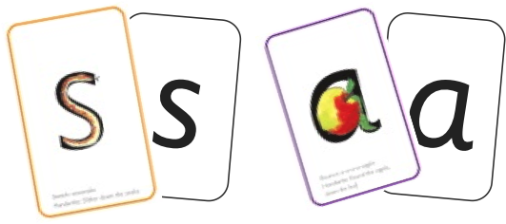

Sounds + blending = reading
+
We teach children to blend sounds to read words.
We use Fred Talk to help children to read.
Notes:
Alongside teaching children sounds, we teach them to blend sounds to read words e.g. s-a-t, sat.
We use Fred Talk to help children read.

Slide 8

Teach spelling using Fred Fingers
We use Fred Fingers to help children sound out words to spell.
It is a tool so they will be able to spell any word.
Notes:
We use Fred Fingers to help children sound out words to spell easily.
It means they do not have to memorise lists of spelling words.
It is a tool so they will be able to spell any word.

Slide 9
‘Read, Write Inc Storybooks
Children practice by reading storybooks which are matched to the sounds that they have learned.
In school children read each RWI storybook 3 times with their partner.
1. Accuracy
2. Fluency
3. Comprehension
The same book is then sent home to read and enjoy with you again and again.
Children are set up to succeed and enjoy reading!
Notes:
In our school, children read each Read Write Inc. Storybook three times in class with their partner.
Re-reading the same book helps children to become confident readers. Each time they re-read, they build their fluency/speed and comprehension.
They love reading and want to read because they can read all of the words in the Storybook.
We set a focus for each re-read in school.
(Click) The first read focuses on reading every word accurately.
(Click) The second on reading the story more quickly.
(Click) The third read on comprehension - understanding what they read.
Then your child brings the same book home to read and enjoy with you again and again at home.
It’s ‘three with me, four at home.’
We do not send stories home the children cannot read because we always want them to be set up to succeed in their reading.
We want to make sure they enjoy reading so that they want to read.
The more they read, the faster progress they will make.

Slide 10
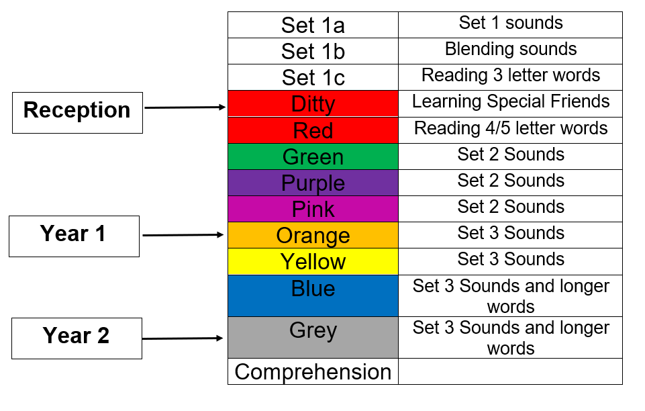
Where should your child be working?
Notes:
We want to make sure every child learns to read in our school.
Some children need extra practice when learning to read so we teach these children one-to-one for ten minutes every day – on top of their group lesson.
We make sure they ‘keep up’ from the beginning and don’t need ‘catch up’ later on.

Slide 11
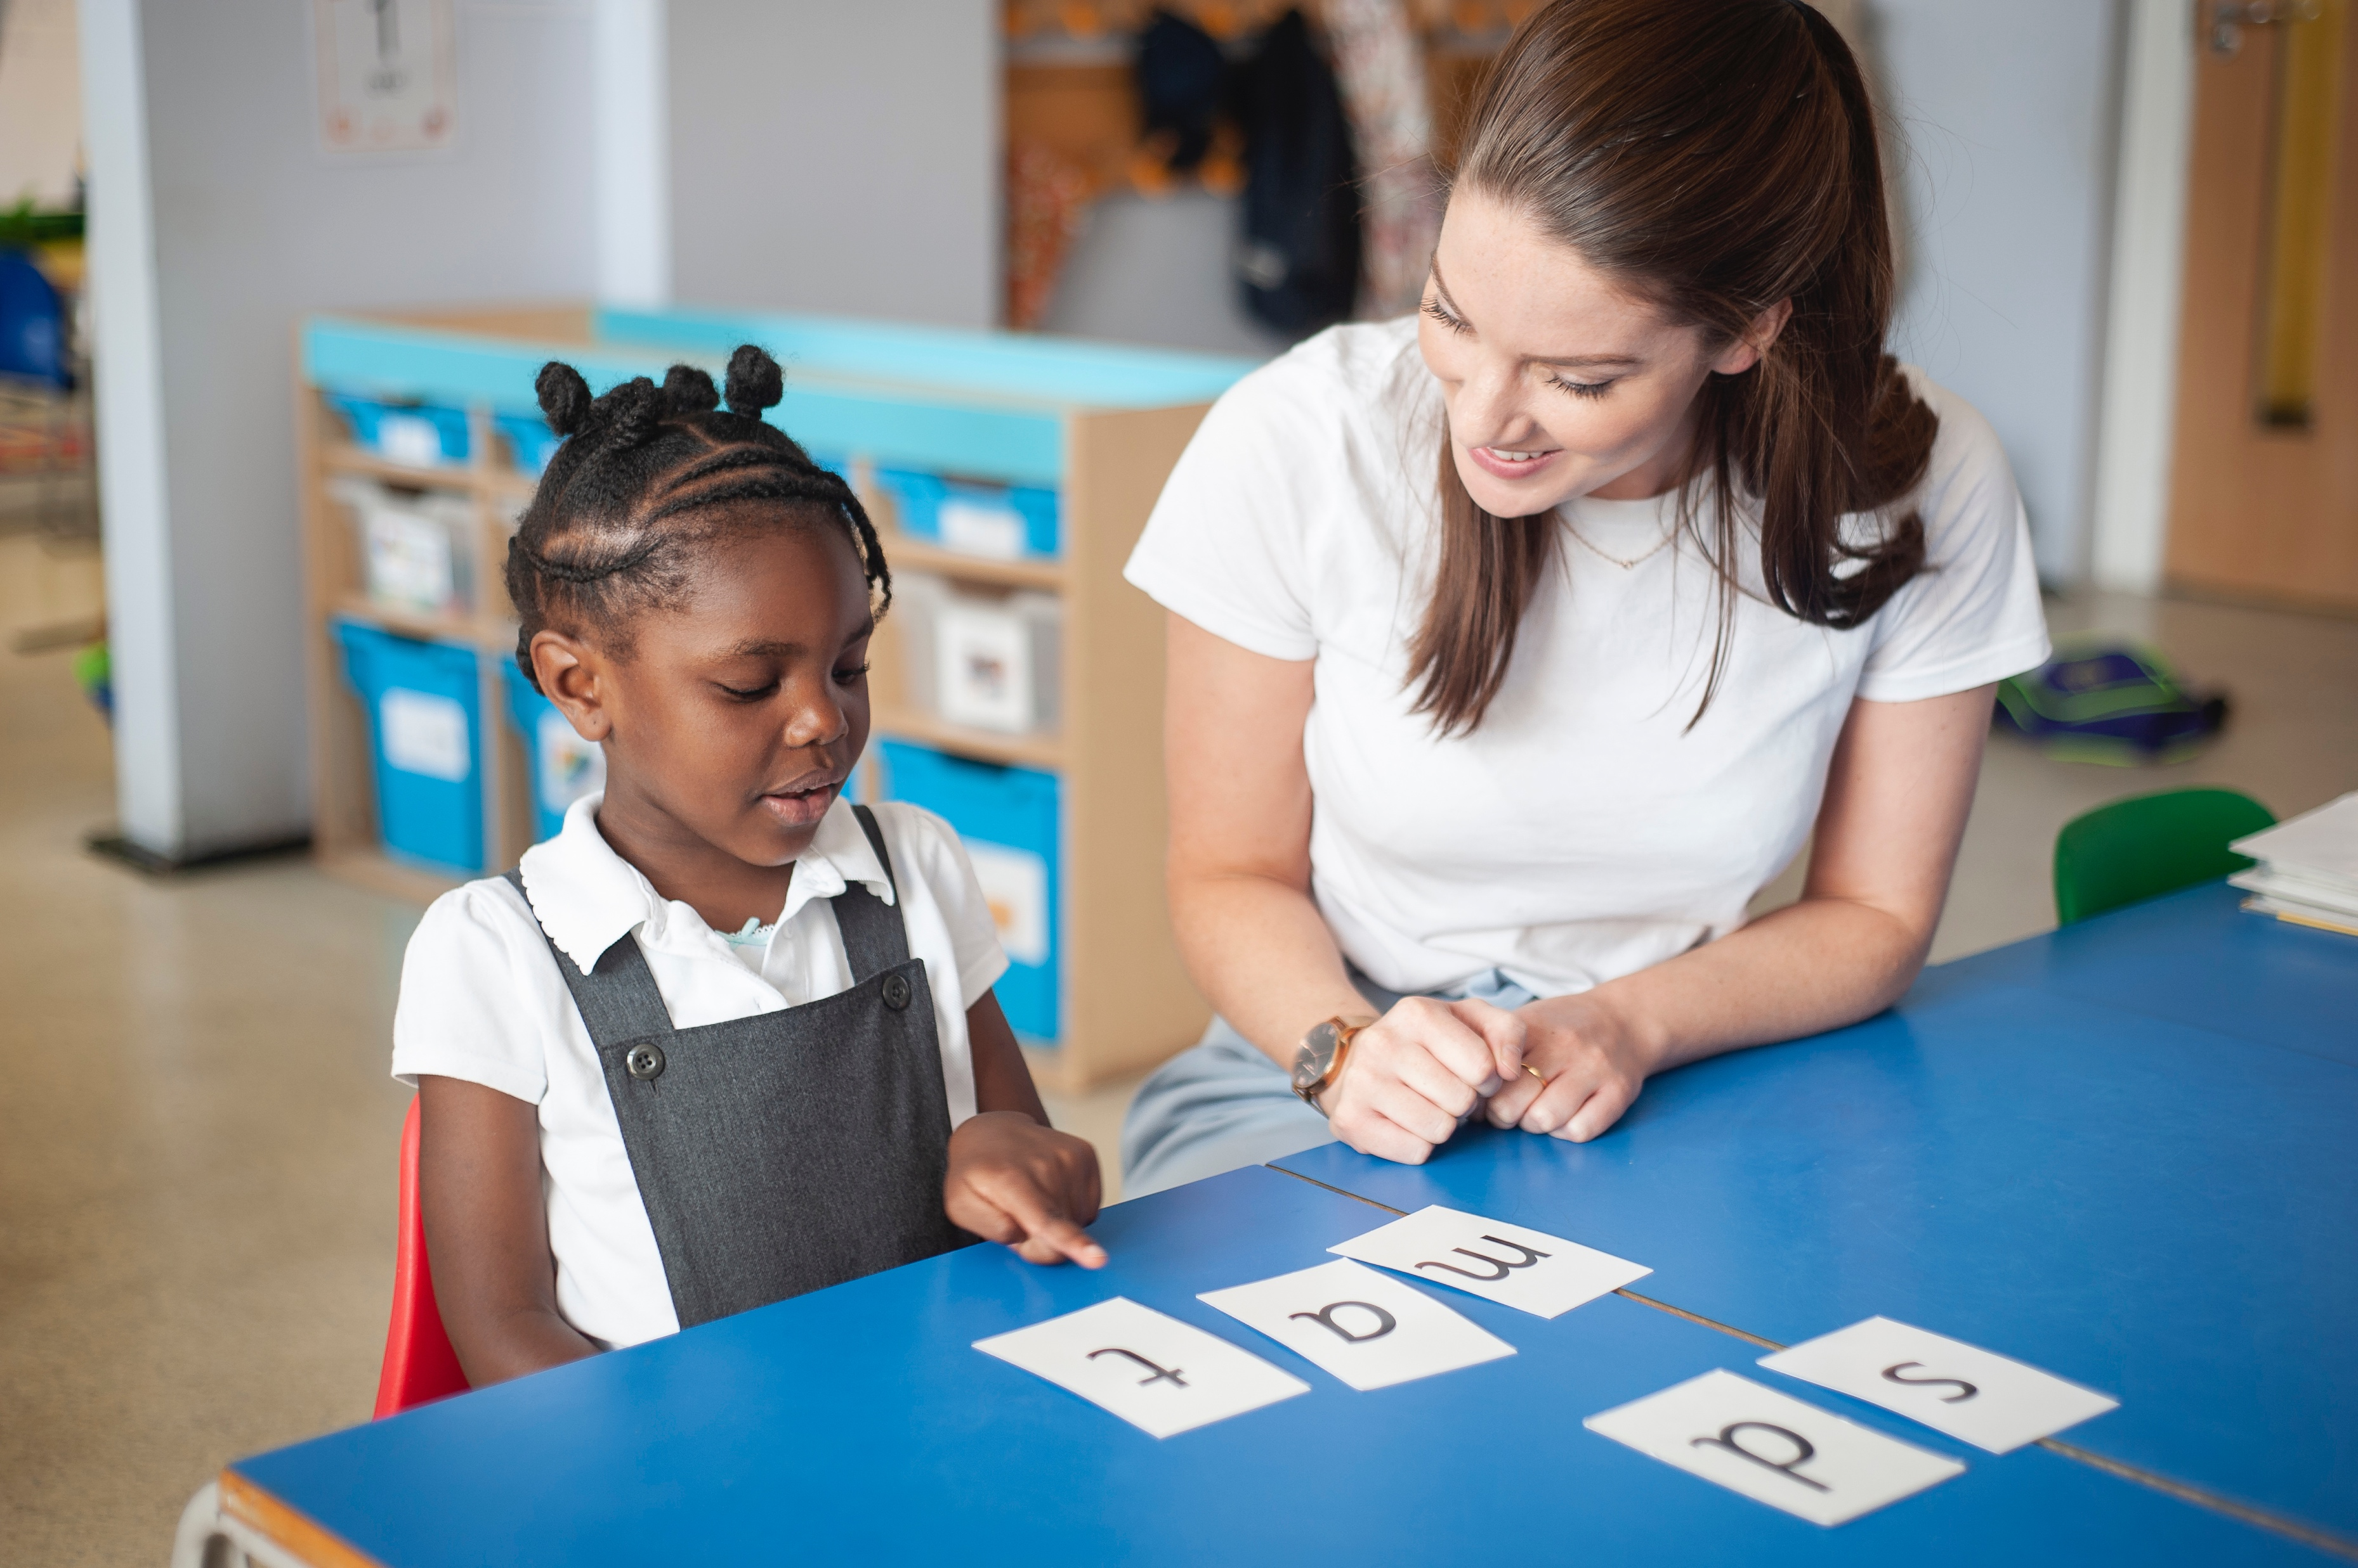
How do we help children who are falling behind?
We want to make sure every child in our school learns to read.
Some children need extra practice when learning to read.
Regular One-to one coaching in addition to their group lessons.
Notes:
We want to make sure every child learns to read in our school.
Some children need extra practice when learning to read so we teach these children one-to-one for ten minutes every day – on top of their group lesson.
We make sure they ‘keep up’ from the beginning and don’t need ‘catch up’ later on.

Slide 12
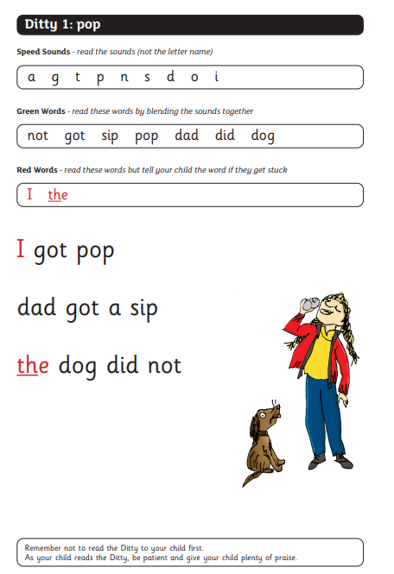
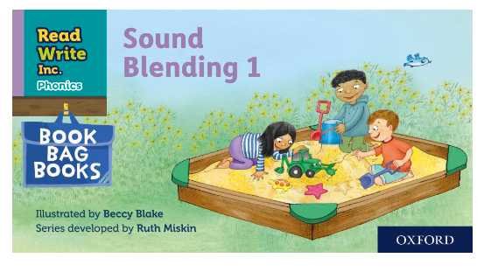
How can I help my child?
Your child will bring home a paper copy of the book they have read at school.
Notes:
In your child’s book bag, they will bring home:
the Storybook they have read in class to practise reading what they can already read.
if applicable a ‘Last and past’ Storybook – a previously read RWI Storybooks for extra practice. The children enjoy re-reading stories they know well. Their fluency improves on every reading.
- if applicable a Book Bag Book.They have guidance inside just for you as parents., They are matched to the books children read in school so provide practice of the same sounds – extra practice at the right level for your child. They include many of the same reading activities that we use in class.
A picture book to share with you which has already been read to them so they care about it. You can read the story to them or they can retell the story by looking at the pictures. They are not expected to read the story themselves.
We make sure that every book that goes into your child’s book bag is a well-loved book – one they know already and want to read again and again.

Slide 13
What can I do with my child?
Get Speedy!
Notes:
In your child’s book bag, they will bring home:
the Storybook they have read in class to practise reading what they can already read.
if applicable a ‘Last and past’ Storybook – a previously read RWI Storybooks for extra practice. The children enjoy re-reading stories they know well. Their fluency improves on every reading.
- if applicable a Book Bag Book.They have guidance inside just for you as parents., They are matched to the books children read in school so provide practice of the same sounds – extra practice at the right level for your child. They include many of the same reading activities that we use in class.
A picture book to share with you which has already been read to them so they care about it. You can read the story to them or they can retell the story by looking at the pictures. They are not expected to read the story themselves.
We make sure that every book that goes into your child’s book bag is a well-loved book – one they know already and want to read again and again.

Slide 14
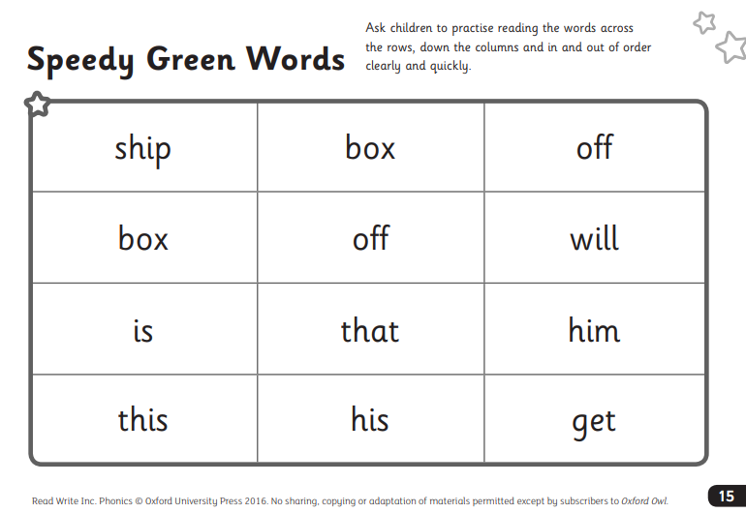
What can I do with my child?
FRED TALK!
Notes:
In your child’s book bag, they will bring home:
the Storybook they have read in class to practise reading what they can already read.
if applicable a ‘Last and past’ Storybook – a previously read RWI Storybooks for extra practice. The children enjoy re-reading stories they know well. Their fluency improves on every reading.
- if applicable a Book Bag Book.They have guidance inside just for you as parents., They are matched to the books children read in school so provide practice of the same sounds – extra practice at the right level for your child. They include many of the same reading activities that we use in class.
A picture book to share with you which has already been read to them so they care about it. You can read the story to them or they can retell the story by looking at the pictures. They are not expected to read the story themselves.
We make sure that every book that goes into your child’s book bag is a well-loved book – one they know already and want to read again and again.

Slide 15
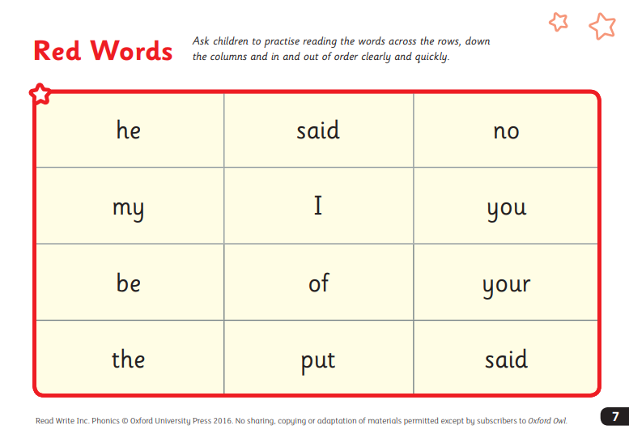
What can I do with my child?
You can’t FRED a RED!
Notes:
In your child’s book bag, they will bring home:
the Storybook they have read in class to practise reading what they can already read.
if applicable a ‘Last and past’ Storybook – a previously read RWI Storybooks for extra practice. The children enjoy re-reading stories they know well. Their fluency improves on every reading.
- if applicable a Book Bag Book.They have guidance inside just for you as parents., They are matched to the books children read in school so provide practice of the same sounds – extra practice at the right level for your child. They include many of the same reading activities that we use in class.
A picture book to share with you which has already been read to them so they care about it. You can read the story to them or they can retell the story by looking at the pictures. They are not expected to read the story themselves.
We make sure that every book that goes into your child’s book bag is a well-loved book – one they know already and want to read again and again.

Slide 16
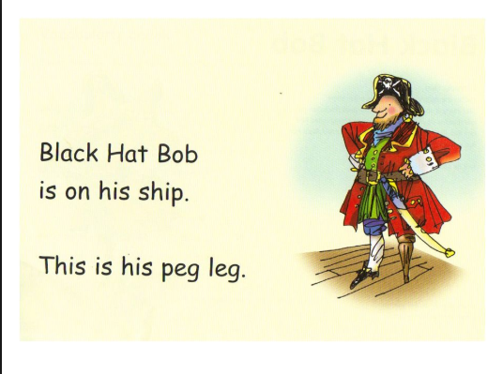
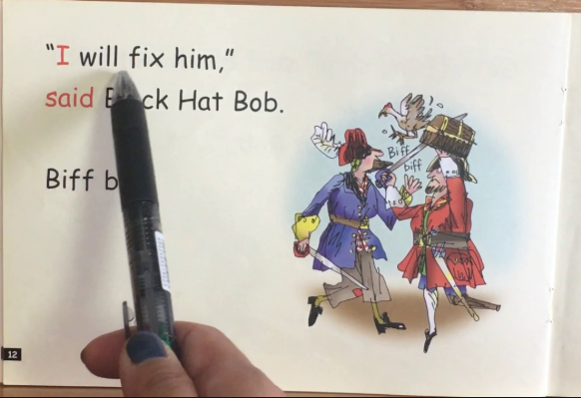
What can I do with my child?
Read, Read, Read!
Notes:
In your child’s book bag, they will bring home:
the Storybook they have read in class to practise reading what they can already read.
if applicable a ‘Last and past’ Storybook – a previously read RWI Storybooks for extra practice. The children enjoy re-reading stories they know well. Their fluency improves on every reading.
- if applicable a Book Bag Book.They have guidance inside just for you as parents., They are matched to the books children read in school so provide practice of the same sounds – extra practice at the right level for your child. They include many of the same reading activities that we use in class.
A picture book to share with you which has already been read to them so they care about it. You can read the story to them or they can retell the story by looking at the pictures. They are not expected to read the story themselves.
We make sure that every book that goes into your child’s book bag is a well-loved book – one they know already and want to read again and again.

Slide 17
What can I do?
Ensure RWI storybooks are in school every day.
Ensure RWI story books are looked after.
Notes:
We will run regular bitesize meetings to look at each of these in more detail.
Provide copies of ‘Reading at Home Booklet 1 or 2’ from Oxford Owl.
Booklet 1 is sound groups and Ditty/ Red Groups and Booklet 2 for Green – Grey Storybooks.

Slide 18
Important points to note…
Use pure sounds, not letter names
Use Fred Talk to read and spell words
Listen to your child read their Storybook every day – it is NEVER too easy!
Read stories to your child every day
Notes:
We will run regular bitesize meetings to look at each of these in more detail.
Provide copies of ‘Reading at Home Booklet 1 or 2’ from Oxford Owl.
Booklet 1 is sound groups and Ditty/ Red Groups and Booklet 2 for Green – Grey Storybooks.

Slide 19
Online resources available
Ruth Miskin Parents’ Page:
http://www.ruthmiskin.com/en/parents/
Ruth Miskin Facebook:
https://www.facebook.com/miskin.education
Free e-books for home reading:
http://www.oxfordowl.co.uk/Reading/

Slide 20
Any other questions
Q&A

Slide 21
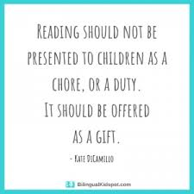
Notes:
Remember that all parents have the power to change outcomes for their children.

