Slide 1
Welcome to the
Year 4 PSHE Workshop

Slide 2

We are learning about changes out of our control.
Menstruation
We do this to inform children about their bodies so they are not scared.
We do this so they know it is normal.
We want all children to treat one another with respect and understanding.
We want all children to feel safe and understood.

Slide 3
We are learning about changes out of our control.
Menstruation
If children ask any questions that extend further from the information we are giving, we will tell them that they will be learning more at a later date in KS2.

Slide 4
Puberty and the male body
Menstruation
Your body will change shape and size.
Your bones grow bigger and heavier.
Hair grows in different places on your body.
Your voice changes.
During puberty, there are fewer changes in males than there are females. But if you feel uncomfortable about any of the changes you experience, you should speak to a safe person.

Slide 5
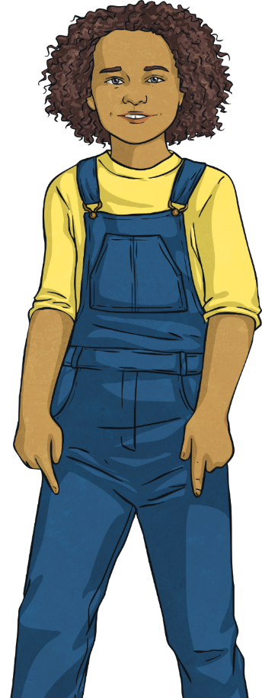
Puberty and the Female Body
Menstruation
Your body will change shape and size.
Your bones grow bigger and heavier.
Hair grows in different places on your body.
Your voice changes.
Your hips get wider and more curvy.
You start your period.
Partner Talk

Slide 6

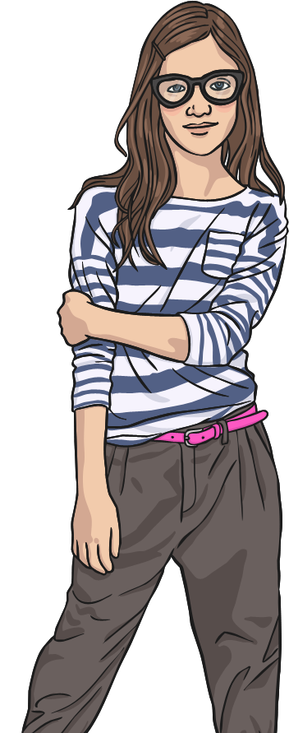
Puberty: What Happens to Girls?
Menstruation
Your body sweats more.
Your body will change shape.
Your internal and external organs grow.
You may have mood swings and different feelings.
Your hair grows in different places and might get darker.

Slide 7
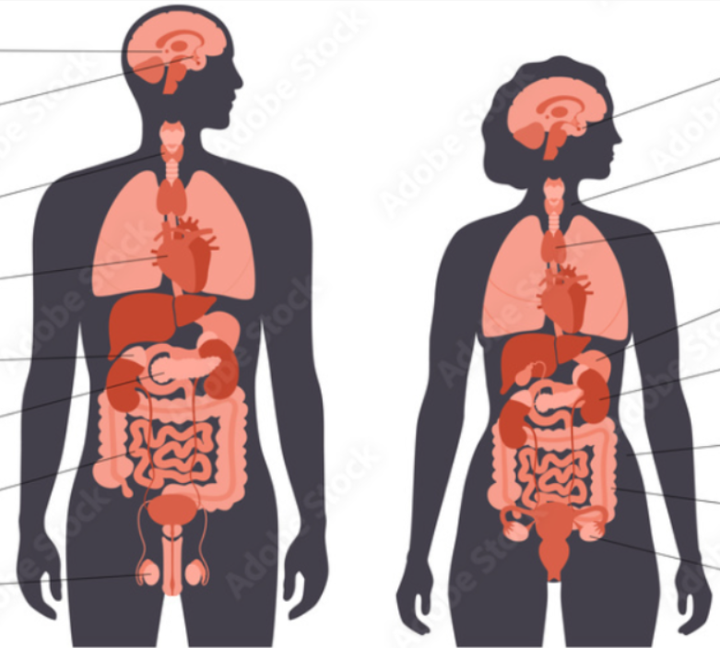
Uterus
Fallopian Tube
Ovaries
Egg (ovum)

Slide 8
What Are Periods?
Menstruation
The egg moves from the ovary and along the fallopian tube and down into the uterus (womb).
Periods (menstruation) happen due to the hormones changing in
the body.
When puberty is reached, an egg is released each month from
the ovaries.
The lining of the uterus and the egg leave the body; this is called a ‘period’.
Even before birth, a female baby has 1-2 million tiny eggs (ovum) in her ovaries.

Slide 9
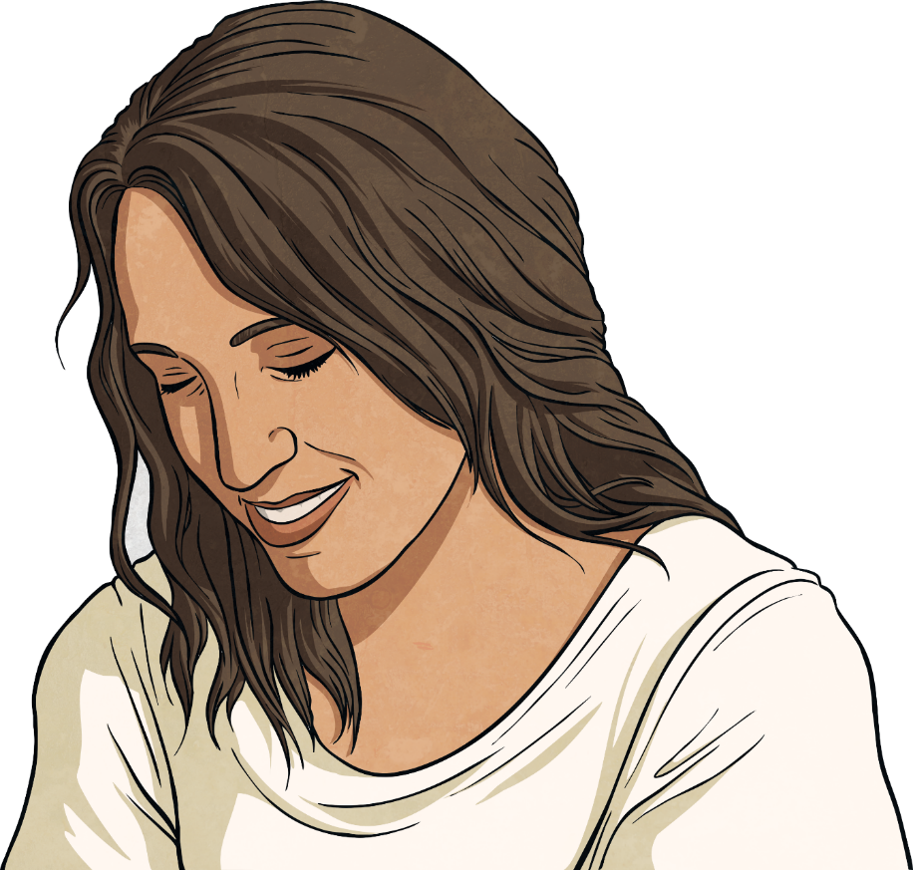
Why Do Periods Start?
Menstruation
Periods are caused by hormone levels changing within your body.
Periods are a normal part of the female reproductive cycle.
It is nature’s way of preparing the body for having a baby when you are older.
They are nothing to feel embarrassed about.
Partner Talk – What questions do you have about periods?

Slide 10
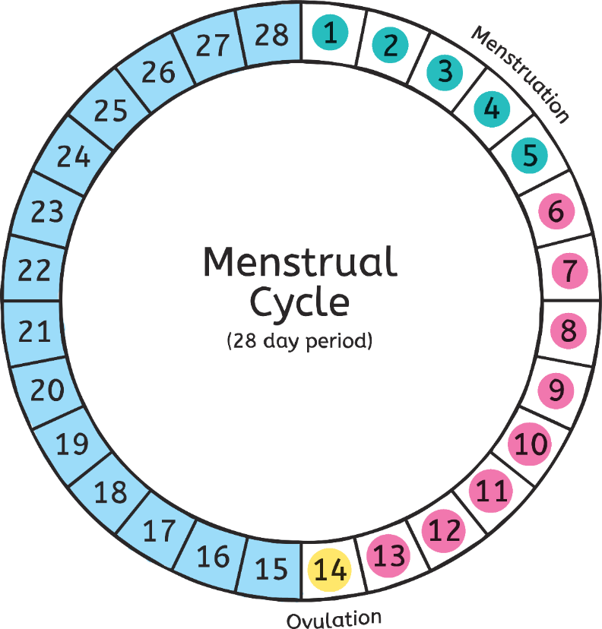
The Menstrual Cycle
Menstruation
The menstrual cycle is usually around 28 days. However, it can vary from between 23-35 days.

Slide 11
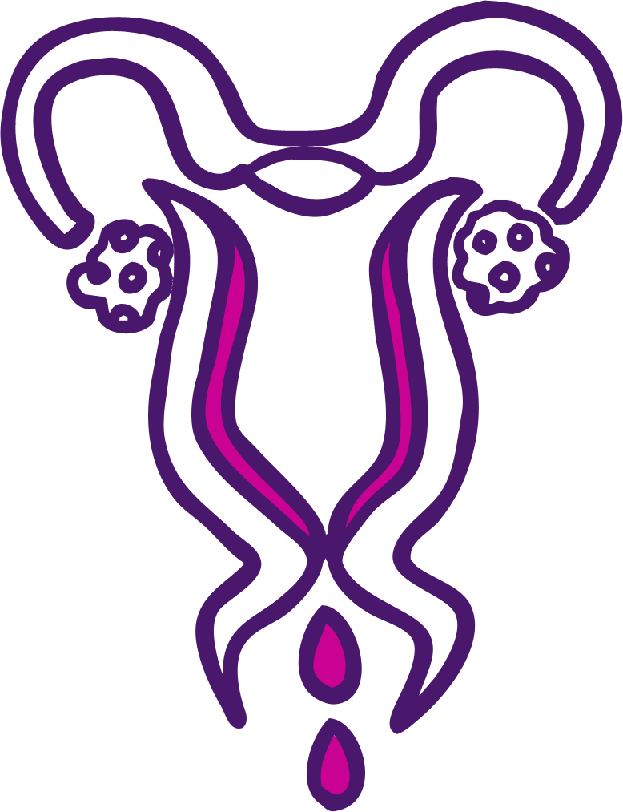
The Menstrual Cycle Days 1-5
Menstruation
Fallopian Tube
Ovary
Uterus
The lining is lost from the uterus.
This is called a period.

Slide 12

The Menstrual Cycle Days 6-13
Menstruation
Fallopian Tube
Ovary
Uterus
The lining of the uterus thickens to be ready to receive an egg.
The egg will start to ripen
on day 12.

Slide 13
The Menstrual Cycle Day 14
Menstruation
Fallopian Tube
Ovary
When ripe, the egg is released from an ovary.
Uterus
This is called ovulation.

Slide 14
The Menstrual Cycle Days 15-28
Menstruation
The cycle will start again.

Slide 15
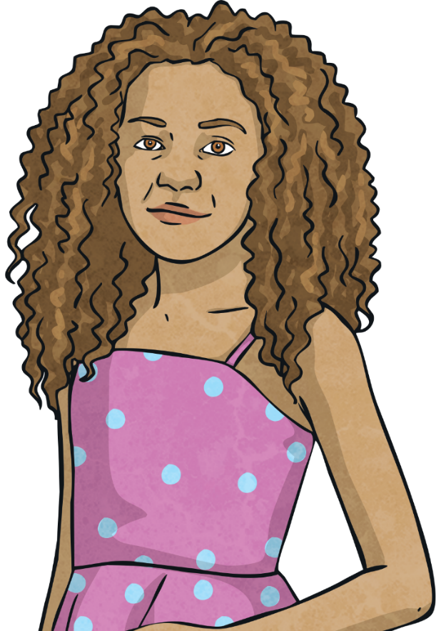
When Will My First Period Start?
Menstruation
Remember - Everyone is different!

Slide 16
What Symptoms Will You Have?
Menstruation
It is common to experience PMS (Pre-Menstrual Syndrome) before a period. The symptoms can include:
aching body
feeling bloated
difficulty concentrating
stomach cramps
tiredness
mood swings
food cravings
headaches
spots
Partner Talk – What could you do to help ease some of these symptoms if they occur?

Slide 17

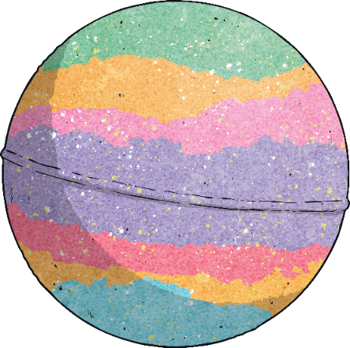
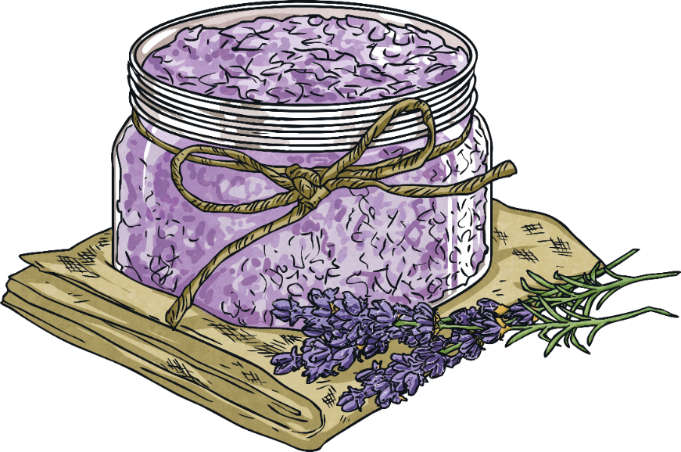
PMS - Things You Can Try!
Menstruation
Have a nice warm drink.
Eat a well balanced diet.
Take part in some gentle exercise.
Massage your stomach.
Use a hot water bottle or use a heat pad.
Have a warm bath.

Slide 18
During Your Period: What Happens?
Menstruation
Bleeding can last between
3 and 8 days.
The average blood loss is only around 3 tablespoons.
Your first period may be so light, you may not even realise that you are having one.
Periods happen approximately once a month .

Slide 19
During Your Period: Feminine Protection
Menstruation
There are many different types of protection you can use during your period to absorb the blood and to stop it getting on to your clothes/underwear.
It is a personal choice and different for each girl. The most common type of protection are:
Sanitary towels

Slide 20
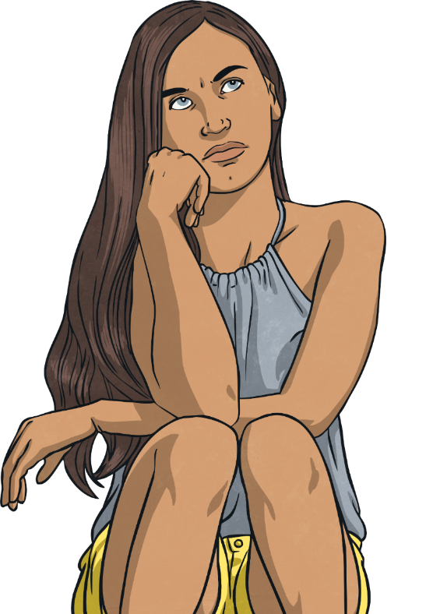
Sanitary Towels
Menstruation
These are worn in your underwear.
Some have sticky tabs called ‘wings’, which help provide extra protection to the sides of your underwear.
They should be changed frequently to keep you fresh and dry.

Slide 21
How Should You Dispose Of Your Feminine Protection Products Appropriately?
Menstruation
Some products are reusable so they don’t need to be disposed of.
Others are single use and should be disposed of after use.
It’s important that these products are disposed of appropriately. The most important rule with all of these single use products is simple, do not flush!
These products should be disposed of in sanitary bins or in ordinary bins if sanitary bins aren’t available.

Slide 22
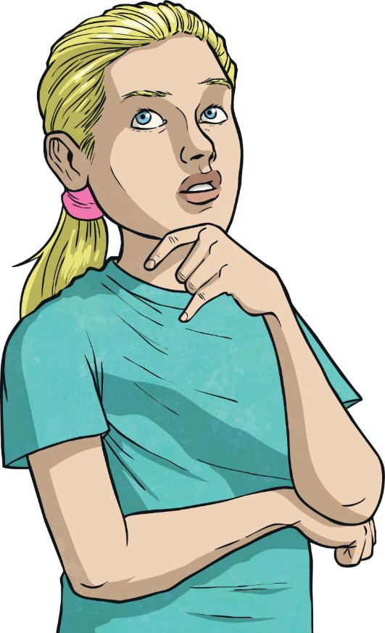
How Will I Know When My Period Will Start?
Menstruation
Count 28 days from the day of your first show of blood. This will give you a rough idea of when your next period will be.
Be Prepared
Carry some spare sanitary towels in your bag. We also have a drawer in school where these can be found.
Remember: Periods will not have a set pattern in the beginning. They will eventually settle into their own pattern after a few months or years.

Slide 23
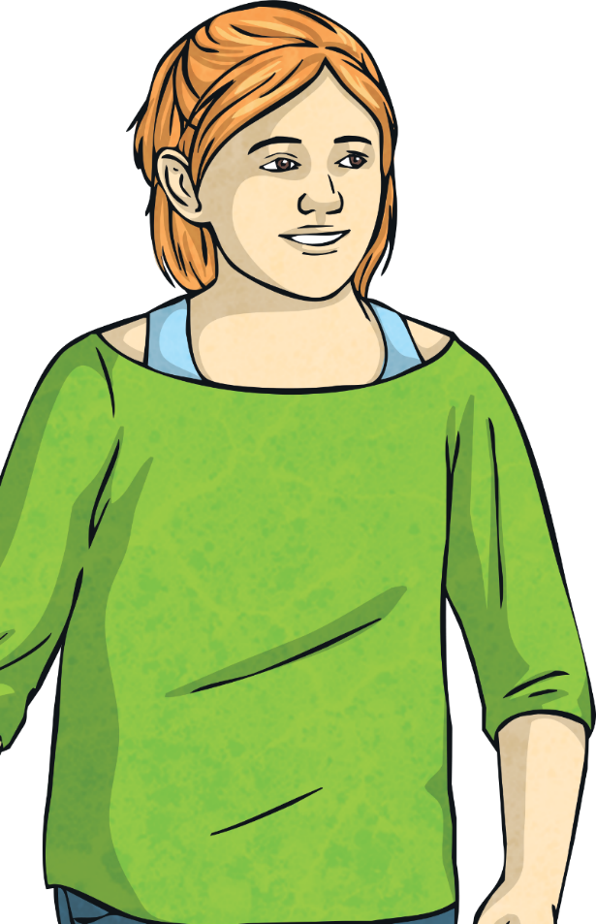
Remember
Menstruation
Having a period is a normal healthy thing to happen.
It is a natural process for the female body.
It can take some time getting used to having periods and feeling confident about dealing with them.
Any question is a good question
Periods are part of being a female.
Do you have any questions you would like to discuss?
Remember: no-one will know that you have your period, unless you tell them.

